Slide 1
State Space models and filtering
Daniel C

Slide 2
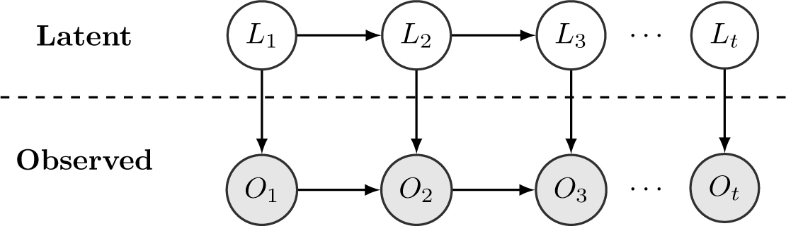
State space models

Slide 3
State space models
Sources of uncertainties:
Disturbances in predictive models
Noises of measurements

Slide 4
State space models
Filtering:
Estimating the current state based on observations
Balance different sources of uncertainties

Slide 5

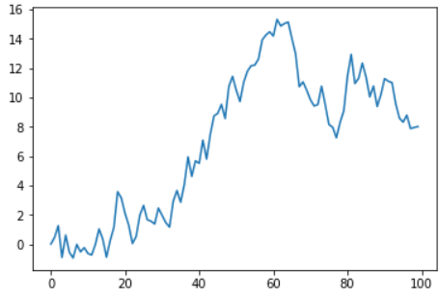
Example: Random walk

Slide 6

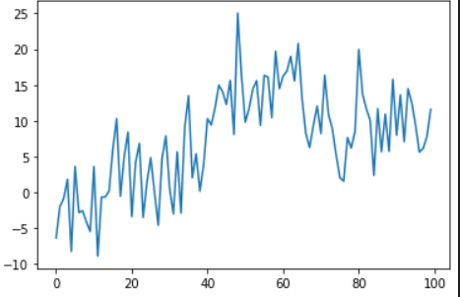
Example: Random walk

Slide 7
Example: Random walk
How can we deduce the first graph from the second graph as much as possible?
Previous estimation + Current observation
Which information do we trust more?
The general update equation:
Estimate=Prediction+K*(Measurement-Prediction)

Slide 8

Alpha beta filter
State contains a quantity and its rate of change
E.g. Position and velocity
Only record position

Slide 9
Alpha beta filter
Alpha: Relative trust in measurement vs prediction of position
Beta: Relative trust in measurement vs prediction of velocity

Slide 10
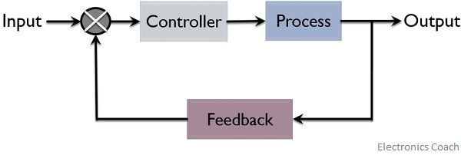
Control
Closed loop control

Slide 11
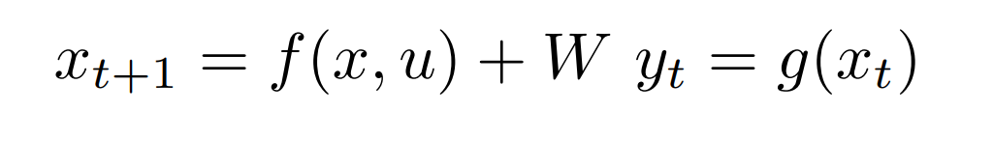
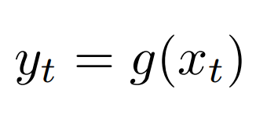
Control
State transition:
Measurement:

Slide 12
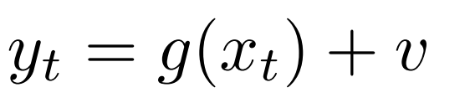
Control with uncertainty
State transition:
Measurement:

Slide 13

Kalman filters
From noisy measurement
To estimation of full state:

Slide 14

Closing the loop
The control law:

Slide 15


Objectives
Target state deviation(e.g. thermostat):
Integral cost(e.g. fuel consumption):

Slide 16
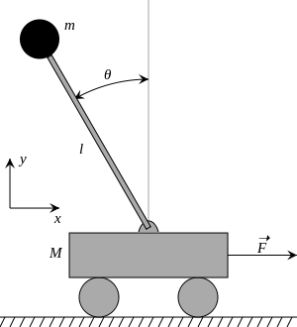
Inverted Pendulum

Slide 17
Inverted Pendulum
States:
Position
Velocity
Angle
Angular velocity

Slide 18
Inverted Pendulum
Disturbances:
Position
Velocity
Normally distributed with variance 0.01
Measurement:
noises on all variables
Normally distributed with variance 0.1

Slide 19
Inverted Pendulum
Disturbances:
Position
Velocity
Normally distributed with variance 0.01
Measurement:
noises on all variables
Normally distributed with variance 0.1

Slide 20
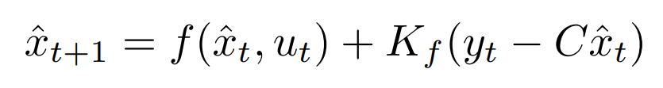
The kalman filter
Computes a matrix Kf based on dynamics
Predict and update the estimate:
Such that expectation of error is minimized

Slide 21

The controller
Linear Quadratic Regulator: Computes a matrix K based on cost and dynamics
The control law is
Minimizes the objective

Slide 22
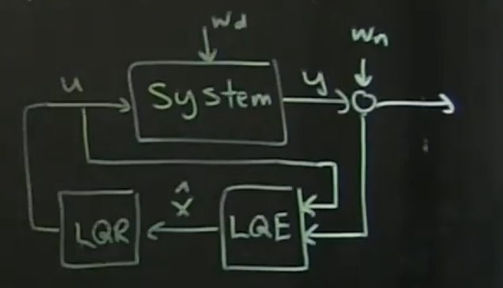
Full picture
Closed loop control with filtering

